Slide 1
Unit testing

Slide 2
Agenda
Testable code – Domain centric architecture
NUnit
Moq – How it works
Demo unit testing
Demo integration testing
Unit testing and Integration testing
What is TDD ?
What is Sonarcube
Q & A

Slide 3
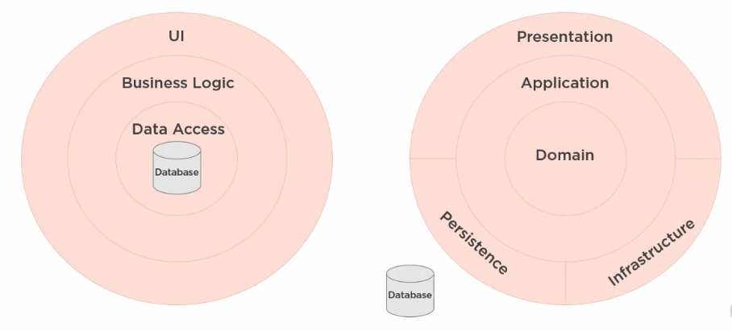
DATABASE-CENTRIC VS. Domain-centric architecture

Slide 4
Onion, CLEAN & Hexagonal arch.
https://jeffreypalermo.com/2008/07/the-onion-architecture-part-1/
https://blog.cleancoder.com/uncle-bob/2012/08/13/the-clean-architecture.html
https://alistair.cockburn.us/hexagonal+architecture

Slide 5
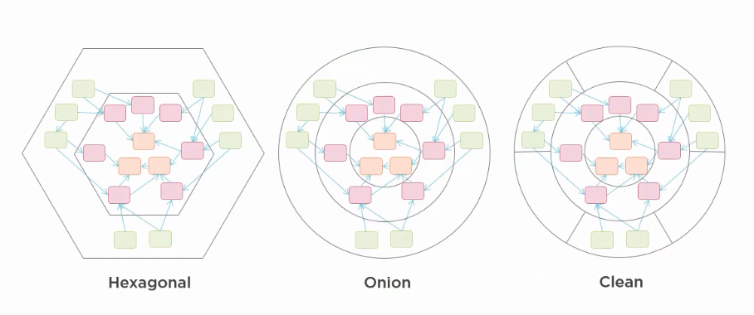
It’s all same thing
https://blog.ploeh.dk/2013/12/03/layers-onions-ports-adapters-its-all-the-same/

Slide 6
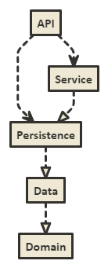

Slide 7
Project demo

Slide 8


Slide 9
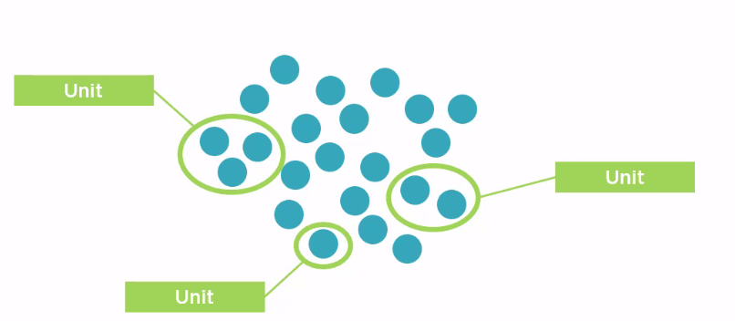

Slide 10
It’s a situational thing – the team decides what makes sense to be a unit for purposes of their understanding of the system and its testing
Martin fowler
https://martinfowler.com/bliki/UnitTest.html

Slide 11
Project demo

Slide 12
Difference b/w testing lib.
 | NUnit Test | xUnit Test | MS TEST 2
Class | [TestFixture] | No | [TestClass]
Single Test Case | [Test] | [Fact] | [TestMethod]
Multi-Data | [TestCase] | [Theory] | [DataTestMethod]
 |  | [InlineData] | [DataRow]
Repeat Initialization for each Test | [SetUp] | Ctor, IDisposable | [TestInitialize]
 | [TearDown] |  | [TestCleanup]
One Time initialization for all tests in one class. | [OneTimeSetUp] | [MemberData] | [ClassInitialize]
 | [OneTimeTearDown] | Or | [ClassCleanup]
 |  | [ClassData]
 |  | Method Member (may Property Member)
One Time initialization for all tests in one assembly | Dedicated class with [SetUpFixture] + [OneTimeSetUp] [OneTimeTearDown] | [MemberData] Or [ClassData] Property Member | [TestClass] + [AssemblyInitialize] [AssemblyCleanup]

Slide 13
Mocking
Replacing actual dependency

Slide 14
Why Mock?
Reduced test complexity
Improved test execution speed
Support parallel development streams
Real dependency not yet available
Another team
Improve test predictability
Reduce testing costs

Slide 15
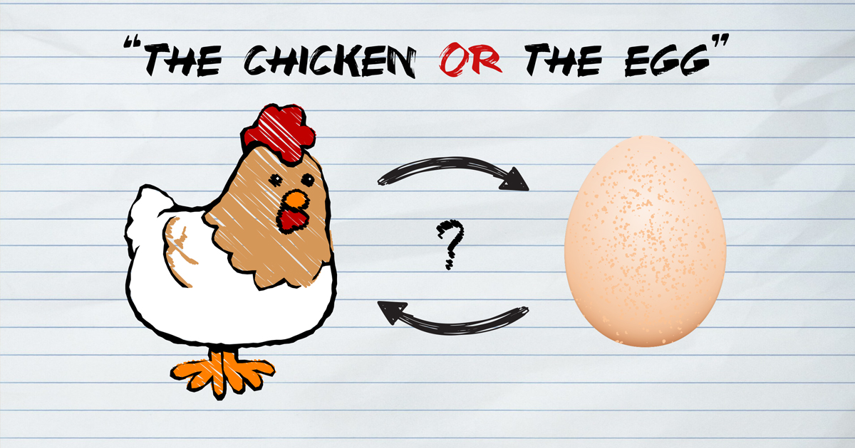
Chicken-egg problem in software development

Slide 16
Test first or code first?
It’s clean code that matters
TDD provides opportunity to create a masterpiece that proactively unbreakable and reduce time to market.

Slide 17
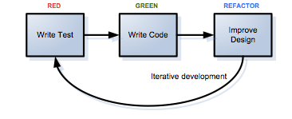
TDD is easier than I thought

Slide 18
Q&A

